Slide 1
Chapter 2. Machine Instructions and Programs

Slide 2
Objectives
Number representation and addition/subtraction in the 2’s-complement system.
Machine instructions and program execution, including branching and subroutine call and return operations.
Addressing methods for accessing register and memory operands.

Slide 3
Number, Arithmetic Operations, and Characters

Slide 4
Signed Integer
3 major representations:
Sign and magnitude
One’s complement
Two’s complement
Assumptions:
4-bit machine word
16 different values can be represented
Roughly half are positive, half are negative

Slide 5
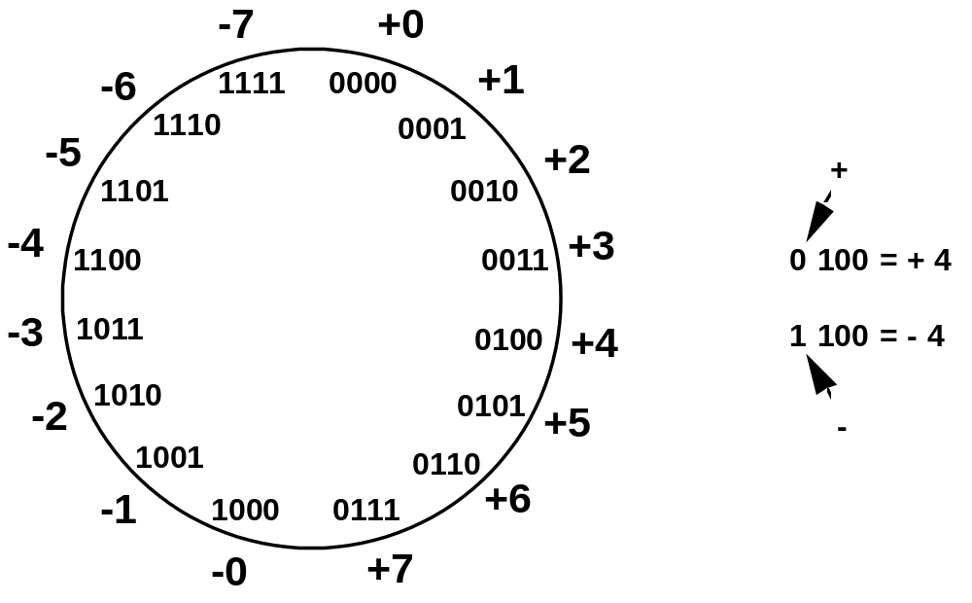
Sign and Magnitude Representation
High order bit is sign: 0 = positive (or zero), 1 = negative
Three low order bits is the magnitude: 0 (000) thru 7 (111)
Number range for n bits = +/-2^{n-1} -1
Two representations for 0

Slide 6
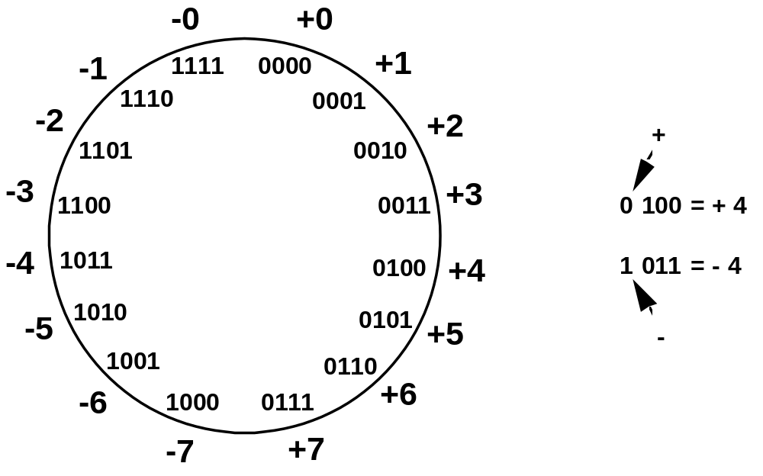
One’s Complement Representation
Subtraction implemented by addition & 1's complement
Still two representations of 0! This causes some problems
Some complexities in addition

Slide 7
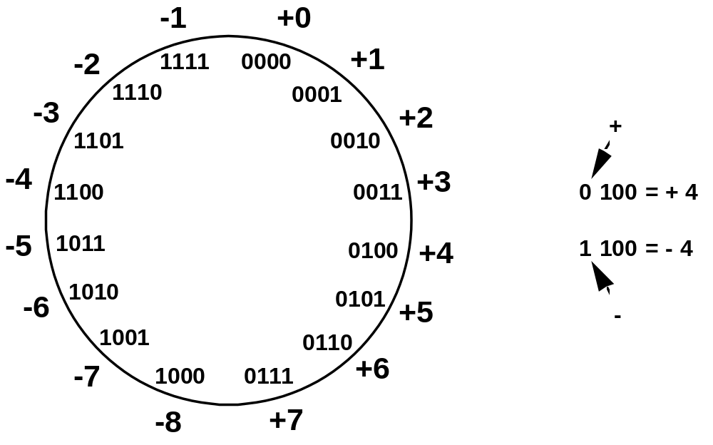
Two’s Complement Representation
like 1's comp
except shifted
one position
clockwise
Only one representation for 0
One more negative number than positive number

Slide 8
Binary, Signed-Integer Representations
Page 28
B
V
alues represented
Sign and
b
3
b
2
b
1
b
0
magnitude
1'
s complement
2'
s complement
0
1
1
1
+
7
+
7
+
7
0
1
1
0
+
6
+
6
+
6
0
1
0
1
+
5
+
5
+
5
0
1
0
0
+
4
+
4
+
4
0
0
1
1
+
3
+
3
+
3
0
0
1
0
+
2
+
2
+
2
0
0
0
1
+
1
+
1
+
1
0
0
0
0
+
0
+
0
+
0
1
0
0
0
-
0
-
7
-
8
1
0
0
1
-
1
-
6
-
7
1
0
1
0
-
2
-
5
-
6
1
0
1
1
-
3
-
4
-
5
1
1
0
0
-
4
-
3
-
4
1
1
0
1
-
5
-
2
-
3
1
1
1
0
-
6
-
1
-
2
1
1
1
1
-
7
-
0
-
1
Figure 2.1. Binary, signed-integer representations.

Slide 9
Addition and Subtraction – 2’s Complement
(4+3, -4+-3, 4-3, -4+3, -4 - -3)
4
+ 3
7
0100
0011
0111
-4
+ (-3)
-7
1100
1101
11001
If carry-in to the high
order bit =
carry-out then ignore
carry
if carry-in differs from
carry-out then overflow
4
- 3
1
0100
1101
10001
-4
+ 3
-1
1100
0011
1111
Simpler addition scheme makes twos complement the most common
choice for integer number systems within digital systems

Slide 10
2’s-Complement Add and Subtract Operations
(a)
0 0 1 0
(
+
2
)
(b)
0 1 0 0
(
+
4
)
Page 31
+
0 0 1 1
(
+
3
)
+
1 0 1 0
(
-
6
)
0 1 0 1
(
+
5
)
1 1 1 0
(
-
2
)
(c)
1 0 1 1
(
-
5
)
(d)
0 1 1 1
(
+
7
)
+
1 1 1 0
(
-
2
)
+
1 1 0 1
(
-
3
)
1 0 0 1
(
-
7
)
0 1 0 0
(
+
4
)
(e)
1 1 0 1
(
-
3
)
1 1 0 1
-
1 0 0 1
(
-
7
)
+
0 1 1 1
0 1 0 0
(
+
4
)
(f)
0 0 1 0
(
+
2
)
0 0 1 0
-
0 1 0 0
(
+
4
)
+
1 1 0 0
1 1 1 0
(
-
2
)
(g)
0 1 1 0
(
+
6
)
0 1 1 0
-
0 0 1 1
(
+
3
)
+
1 1 0 1
0 0 1 1
(
+
3
)
(h)
1 0 0 1
(
-
7
)
1 0 0 1
-
1 0 1 1
(
-
5
)
+
0 1 0 1
1 1 1 0
(
-
2
)
(i)
1 0 0 1
(
-
7
)
1 0 0 1
-
0 0 0 1
(
+
1
)
+
1 1 1 1
1 0 0 0
(
-
8
)
(j)
0 0 1 0
(
+
2
)
0 0 1 0
-
1 1 0 1
(
-
3
)
+
0 0 1 1
0 1 0 1
(
+
5
)
Figure 2.4. 2's-complement Add and Subtract operations.

Slide 11
Overflow - Add two positive numbers to get a negative number or two negative numbers to get a positive number
-1
+0
-1
+0
-2
1111
0000
+1
-2
1111
0000
+1
-3
1110
0001
-3
1110
0001
1101
+2
1101
+2
-4
0010
-4
0010
1100
0011
+3
1100
0011
+3
-5
1011
-5
0100
+4
1011
0100
+4
-6
1010
-6
1010
0101
+5
0101
+5
1001
0110
1001
0110
-7
1000
+6
-7
+6
0111
1000
0111
-8
+7
-8
+7
5 + 3 = -8
-7 - 2 = +7

Slide 12
Overflow Conditions
0 1 1 1
0 1 0 1
0 0 1 1
1 0 0 0
1 0 0 0
1 0 0 1
1 1 0 0
1 0 1 1 1
5
3
-8
-7
-2
7
Overflow
Overflow
0 0 0 0
0 1 0 1
0 0 1 0
0 1 1 1
1 1 1 1
1 1 0 1
1 0 1 1
1 1 0 0 0
5
2
7
-3
-5
-8
No overflow
No overflow
Overflow when carry-in to the high-order bit does not equal carry out

Slide 13
Sign Extension
Task:
  Given w-bit signed integer x
  Convert it to w+k-bit integer with same value
Rule:
  Make k copies of sign bit:
  X ′ = x_{w–1} ,…, x_{w–1} , x_{w–1} , x_{w–2} ,…, x₀
w
X
• • •
k copies of MSB
• • •
X ′
• • •
• • •
k
w

Slide 14
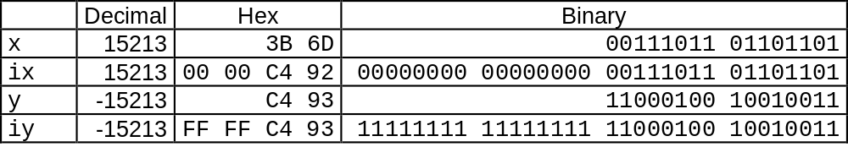
Sign Extension Example
short int x = 15213;
int ix = (int) x;
short int y = -15213;
int iy = (int) y;

Slide 15
Memory Locations, Addresses, and Operations

Slide 16
Memory Location, Addresses, and Operation
n
bits
Memory consists of many millions of storage cells, each of which can store 1 bit.
Data is usually accessed in n-bit groups. n is called word length.
first word
second word
•
•
•
i
th word
•
•
•
last word
Figure 2.5. Memory words.

Slide 17
Memory Location, Addresses, and Operation
32-bit word length example
32 bits
•
•
•
b
31
b
30
b
1
b
0
Sign bit:
b
31
=
0
for positive numbers
b
31
=
1
for negative numbers
(a) A signed integer
8 bits
8 bits
8 bits
8 bits
ASCII
ASCII
ASCII
ASCII
character
character
character
character
(b) Four characters

Slide 18
Memory Location, Addresses, and Operation
To retrieve information from memory, either for one word or one byte (8-bit), addresses for each location are needed.
A k-bit address memory has 2^{k} memory locations, namely 0 – 2^{k}-1, called memory space.
24-bit memory: 2²⁴ = 16,777,216 = 16M (1M=2²⁰)
32-bit memory: 2³² = 4G (1G=2³⁰)
1K(kilo)=2¹⁰
1T(tera)=2⁴⁰

Slide 19
Memory Location, Addresses, and Operation
It is impractical to assign distinct addresses to individual bit locations in the memory.
The most practical assignment is to have successive addresses refer to successive byte locations in the memory – byte-addressable memory.
Byte locations have addresses 0, 1, 2, … If word length is 32 bits, the successive words are located at addresses 0, 4, 8,…

Slide 20
Big-Endian and Little-Endian Assignments
Big-Endian: lower byte addresses are used for the most significant bytes of the word
Little-Endian: opposite ordering. lower byte addresses are used for the less significant bytes of the word
W
ord
address
Byte address
Byte address
0
0
1
2
3
0
3
2
1
0
4
4
5
6
7
4
7
6
5
4
•
•
•
•
•
•
2
k
-
4
2
k
-
4
2
k
-
3
2
k
-
2
2
k
-
1
2
k
-
4
2
k
-
1
2
k
-
2
2
k
-
3
2
k
-
4
(a) Big-endian assignment
(b) Little-endian assignment
Figure 2.7. Byte and word addressing.

Slide 21
Memory Location, Addresses, and Operation
Address ordering of bytes
Word alignment
  Words are said to be aligned in memory if they begin at a byte addr. that is a multiple of the num of bytes in a word.
    16-bit word: word addresses: 0, 2, 4,….
    32-bit word: word addresses: 0, 4, 8,….
    64-bit word: word addresses: 0, 8,16,….
Access numbers, characters, and character strings

Slide 22
Memory Operation
Load (or Read or Fetch)
Copy the content. The memory content doesn’t change.
Address – Load
Registers can be used
Store (or Write)
Overwrite the content in memory
Address and Data – Store
Registers can be used
How is byte stored in a register?

Slide 23
Instruction and Instruction Sequencing

Slide 24
“Must-Perform” Operations
Data transfers between the memory and the processor registers
Arithmetic and logic operations on data
Program sequencing and control
I/O transfers

Slide 25
Register Transfer Notation
Identify a location by a symbolic name standing for its hardware binary address (LOC, R0,…)
Contents of a location are denoted by placing square brackets around the name of the location (R1←[LOC], R3 ←[R1]+[R2])
Register Transfer Notation (RTN)

Slide 26
Assembly Language Notation
Represent machine instructions and programs.
Move LOC, R1 => R1←[LOC]
Add R1, R2, R3 => R3 ←[R1]+[R2]
C=A+B in high level language
C← [A]+[B]
ADD A,B,C; 3 address instruction
ADD A,B ; 2 address
How to prevent overwriting using 2 address?

Slide 27
CPU Organization
Single Accumulator
  Result usually goes to the Accumulator
  Accumulator has to be saved to memory quite often
General Register
  Registers hold operands thus reduce memory traffic
  Register bookkeeping
Stack
  Operands and result are always in the stack

Slide 28
Instruction Formats
Three-Address Instructions
  ADD R1, R2, R3 R1 ← R2 + R3
  ADD A,B,C
Two-Address Instructions
  ADD R1, R2 R1 ← R1 + R2
  ADD A,B
One-Address Instructions
  ADD B AC ← AC + M[B]
Zero-Address Instructions
  ADD TOS ← TOS + (TOS – 1)
Instruction
Opcode
Operand(s) or Address(es)

Slide 29
In one address
  LOAD B ;AC← M[B]
  STORE B ;M[B]←AC
Steps in C← [A]+[B] in one address?

Slide 30
Instruction Formats
Example: Evaluate X=(A+B) ∗ (C+D)
Three-Address
  ADD R1, A, B ; R1 ← M[A] + M[B]
  ADD R2, C, D ; R2 ← M[C] + M[D]
  MUL X, R1, R2 ; M[X] ← R1 ∗ R2

Slide 31
Instruction Formats
Example: Evaluate (A+B) ∗ (C+D)
Two-Address
  MOV R1, A ; R1 ← M[A]
  ADD R1, B ; R1 ← R1 + M[B]
  MOV R2, C ; R2 ← M[C]
  ADD R2, D ; R2 ← R2 + M[D]
  MUL R1, R2 ; R1 ← R1 ∗ R2
  MOV X, R1 ; M[X] ← R1

Slide 32
Instruction Formats
Example: Evaluate (A+B) ∗ (C+D)
One-Address
  LOAD A ; AC ← M[A]
  ADD B ; AC ← AC + M[B]
  STORE T ; M[T] ← AC
  LOAD C ; AC ← M[C]
  ADD D ; AC ← AC + M[D]
  MUL T ; AC ← AC ∗ M[T]
  STORE X ; M[X] ← AC

Slide 33
Instruction Formats
Example: Evaluate (A+B) ∗ (C+D)
Zero-Address
  PUSH A ; TOS ← A
  PUSH B ; TOS ← B
  ADD ; TOS ← (A + B)
  PUSH C ; TOS ← C
  PUSH D ; TOS ← D
  ADD ; TOS ← (C + D)
  MUL ; TOS ← (C+D)∗(A+B)
  POP X ; M[X] ← TOS

Slide 34
Using Registers
Registers are faster
Shorter instructions
  The number of registers is smaller (e.g. 32 registers need 5 bits)
Potential speedup
Minimize the frequency with which data is moved back and forth between the memory and processor registers.

Slide 35
Using Registers contd…
Instructions where only register names are contained , will normally fit into one word.
Add Ri,Rj;
Add Ri,Rj,Rk;
C=A+B
  MOVE Rj, A
  MOVE Rk,B
  ADD Rj,Rk
  MOVE C,Rj

Slide 36
Instruction Execution and Straight-Line Sequencing c←[A]+[B]
Address
Contents
Assumptions:
- One memory operand
per instruction
- 32-bit word length
- Memory is byte
addressable
- Full memory address
can be directly specified
in a single-word instruction
Begin execution here
i
Move
A,R0
3-instruction
i
+ 4
Add
B,R0
program
segment
i
+ 8
Move
R0,C
A
B
Data for
the program
Two-phase procedure
Instruction fetch
Instruction execute
C
Page 43
Figure 2.8. A program for C ← [Α] + [Β].

Slide 37
Branching
i
Move
NUM1,R0
i
+
4
Add
NUM2,R0
i
+
8
Add
NUM3,R0
•
•
•
i
+
4
n
-
4
Add
NUM
n
,R0
i
+
4
n
Move
R0,SUM
•
•
•
SUM
NUM1
NUM2
•
•
•
NUM
n
Figure 2.9. A straight-line program for adding n numbers.

Slide 38
Branching
Move
N,R1
Clear
R0
LOOP
Determine address of
"Next" number and add
Program
"Next" number to R0
loop
Decrement
R1
Branch target
Branch>0
LOOP
Move
R0,SUM
Conditional branch
•
•
•
SUM
N
n
NUM1
Figure 2.10. Using a loop to add n numbers.
NUM2
•
•
•
NUM
n

Slide 39
Condition Codes
Condition code flags
Condition code register / status register
N (negative)
Z (zero)
V (overflow)
C (carry)
Different instructions affect different flags
Ex: Branch>0 tests Z flag

Slide 40
Conditional Branch Instructions
A: 1 1 1 1 0 0 0 0
Example:
  A: 1 1 1 1 0 0 0 0
  B: 0 0 0 1 0 1 0 0
+(−B): 1 1 1 0 1 1 0 0
1 1 0 1 1 1 0 0
C = 1
Z = 0
S = 1
V = 0

Slide 41

Status Bits
C_{n-1}
A
B
C_{n}
ALU
F
V
Z
S
C
F_{n-1}
Zero Check

Slide 42
Addressing Modes

Slide 43
Generating Memory Addresses
How to specify the address of branch target?
Can we give the memory operand address directly in a single Add instruction in the loop?
Use a register to hold the address of NUM1; then increment by 4 on each pass through the loop.

Slide 44
Addressing Modes
Different ways in which location of an operand is specified in an instruction
Implied
  AC is implied in “ADD M[AR]” in “One-Address” instr.
  TOS is implied in “ADD” in “Zero-Address” instr.
Immediate
  The use of a constant in “MOV R1, 5”, i.e. R1 ← 5
Register
  Indicate which register holds the operand
Instruction
Opcode
Mode
...

Slide 45
Addressing Modes
Register Indirect
  Indicate the register that holds the number of the register that holds the operand
    MOV R1, (R2)
Autoincrement / Autodecrement
  Access & update in 1 instr.
Direct Address(or absolute address)
  Use the given address to access a memory location
R1
R2 = 3
R3 = 5

Slide 46
Addressing Modes
Indirect Address
  Indicate the memory location that holds the address of the memory location that holds the data
Memory
AR = 101
100
A=*B
Move R1,B
Move R2,(R1)
101
0 1 0 4
102
103
104
1 1 0 A

Slide 47
Relative Addressing
Relative mode – the effective address is determined by the Index mode using the program counter in place of the general-purpose register.
X(PC) – note that X is a signed number
Branch>0 LOOP
This location is computed by specifying it as an offset from the current value of PC.
Branch target may be either before or after the branch instruction, the offset is given as a singed num.

Slide 48
Addressing Modes
Memory
Relative Address
  EA = PC + Relative Addr
0
1
Program
PC = 2
2
+
100
Data
AR = 100
101
102
1 1 0 A
Could be Positive or Negative
(2’s Complement)
103
104

Slide 49
Addressing Modes
Base Register
  EA = Base Register + Relative Addr
Memory
Could be Positive or Negative
(2’s Complement)
AR = 2
+
100
0 0 0 5
BR = 100
101
0 0 1 2
102
0 0 0 A
Usually points to the beginning of an array
103
0 1 0 7
104
0 0 5 9

Slide 50
Addressing Modes
Name
Assem
bler
syn
tax
Addressing
function
The different ways in which the location of an operand is specified in an instruction are referred to as addressing modes.
Immediate
#V
alue
Op
erand
=
V
alue
Register
R
i
EA
=
R
i
Absolute
(Direct)
LOC
EA
=
LOC
Indirect
(R
i
)
EA
=
[R
i
]
(LOC)
EA
=
[LOC]
Index
X(R
i
)
EA
=
[R
i
]
+
X
Base
with
index
(R
i
,R
j
)
EA
=
[R
i
]
+
[R
j
]
Base
with
index
X(R
i
,R
j
)
EA
=
[R
i
]
+
[R
j
]
+
X
and
offset
Relative
X(PC)
EA
=
[PC]
+
X
Autoincremen
t
(R
i
)+
EA
=
[R
i
]
;
Incremen
t
R
i
Autodecrement
−
(R
i
)
Decremen
t
R
i
;
EA
=
[R
i
]

Slide 51
Indexing and Arrays
Index mode – the effective address of the operand is generated by adding a constant value to the contents of a register.
Index register
X(R_{i}): EA = X + [R_{i}]
The constant X may be given either as an explicit number or as a symbolic name representing a numerical value.
If X is shorter than a word, sign-extension is needed.

Slide 52
Indexing and Arrays
In general, the Index mode facilitates access to an operand whose location is defined relative to a reference point within the data structure in which the operand appears.
Several variations:
(R_{i}, R_{j}): EA = [R_{i}] + [R_{j}]
X(R_{i}, R_{j}): EA = X + [R_{i}] + [R_{j}]

Slide 53
Additional Modes
Autoincrement mode – the effective address of the operand is the contents of a register specified in the instruction. After accessing the operand, the contents of this register are automatically incremented to point to the next item in a list.
(R_{i})+. The increment is 1 for byte-sized operands, 2 for 16-bit operands, and 4 for 32-bit operands.
Autodecrement mode: -(R_{i}) – decrement first
Move
N,R1
Move
#NUM1,R2
Initialization
Clear
R0
LOOP
Add
(R2)+,R0
Decrement
R1
Branch>0
LOOP
Move
R0,SUM
Figure 2.16. The Autoincrement addressing mode used in the program of Figure 2.12.

